Slide 1
Production Feed - Automation
Problem Statement: Automation scripts are not able to run Umbrella Service test cases with random copied production policies to lower environments.
<Archana> To accomplish regression execution with real time scenarios team is planning to copy the production policies to lower environments . We need to come up with Strategy to absorb this data in our automation suite without much manual intervention
.
Any Active Policy: 15%
  Add a vehicle which is not insured. Verify the error message.
  Endorse policy to Update Primary Residence Address. Verify zipcode+4 is showing in Dec page.
  Add a secondary address not located in US. Verify the message.
  Adding a property with commercial use = Yes. Verify the message.
  Navigate to cancel policy and click on discard. Verify the warning message
Condition Policy: 85%
  Active UMB Policy with 1D, 1V, 1PR and No Watercraft. Verify Rewrite Allowed
  Active UMB Policy enrolled with RPM. Make a payment with a third party payee and verify attributes
  Active UMB Policy with 2D (NIN, DRSP) 1V, 1PR and No Watercraft. Verify spouse changed to NIN
  Policy with active NIN and DRSN . Change DRSN status and verify results.
  Active Umbrella policy with more than 4 Active rental properties.
  Active UMB policy with driver has a current license status of suspended. Verify message
Application | No. of Test Cases
Service Customer | 97
Service Counselor | 465
DC Billing Counselor | 34

Slide 2
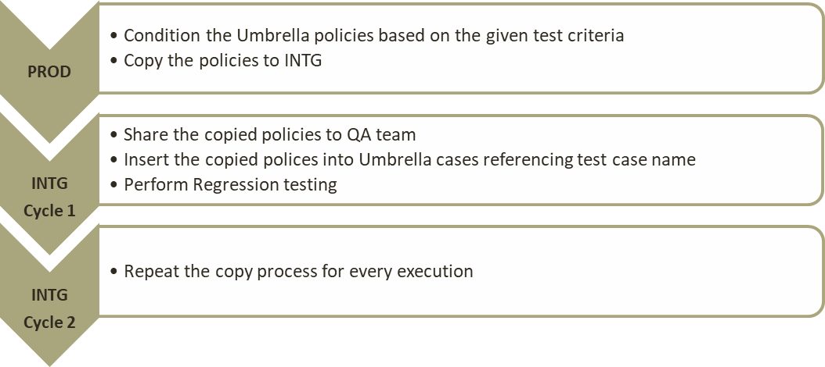
Approach 1 – Service Cases
Policy condition process:
  Dev/Analyst to write one time query as per the test criteria
  Dev can set the read only status to the policies to avoid updating the policies by other teams, and can release
  read only to read and write on demand.
Challenges:
  Copy data should takes place day before the execution

Slide 3
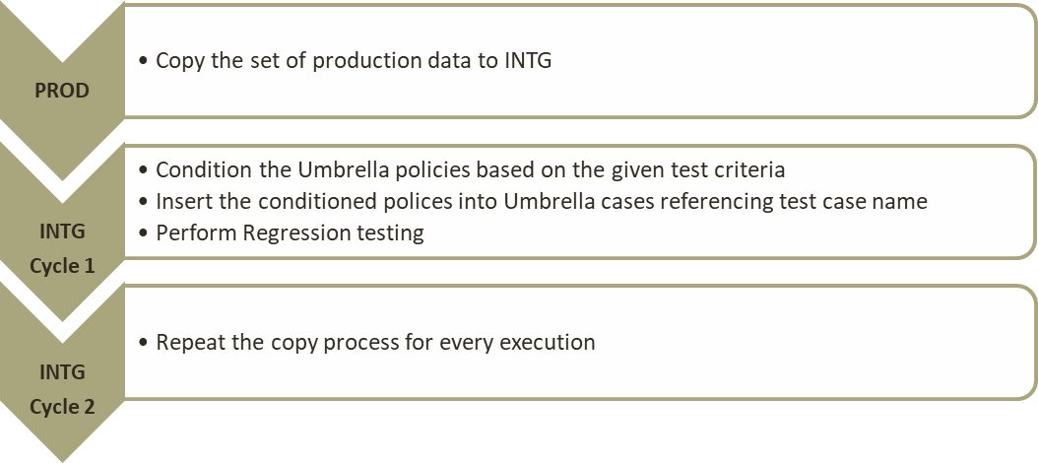
Approach 2 – Service Cases
Policy condition process:
  Dev/Analyst to write one time query as per the test criteria
  Dev can set the read only status to the policies to avoid updating the policies by other teams, and can release
  read only to read and write on demand.
Challenges:
  Copied data might not have the policies required for the entire test suite criteria

Slide 4
Tools and Constraints
Tools:
  TDM
  Data San
Features:
  Data San back up Auto policies to DBDR(Data Repository) and can be restored with original state to any lower environment on demand. This helps re-use the policies.
  Data San overrides the existing data if copied same Auto policy
  TDM overrides the existing data if copied same Umbrella policy
  No systems are impacted if copied the same policy over and over
Constraints:
  TDM does not have an Umbrella policy back up mechanism like Data San has DBDR
Improvements:
  TDM tool can provision a back up of Umbrella policies mechanism if required

